Slide 1


HR Analytics Project
Digital Egypt Pioneers

Slide 2
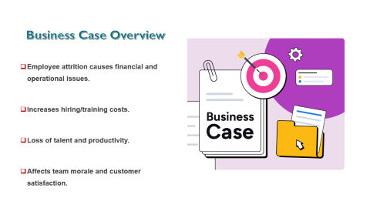
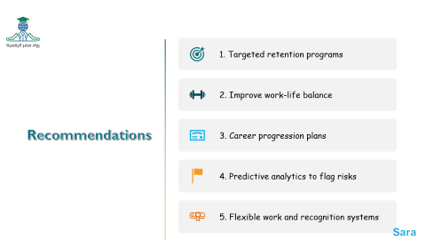
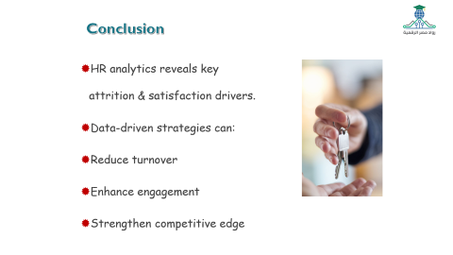

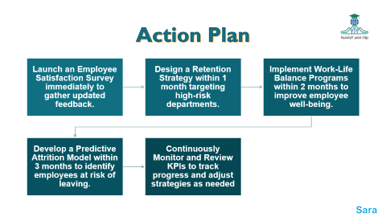
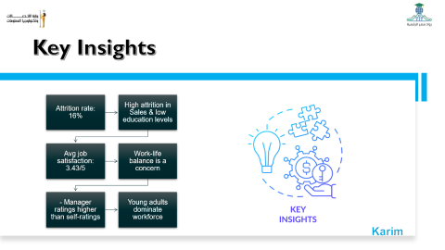
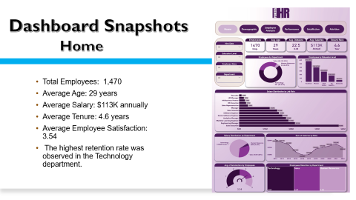
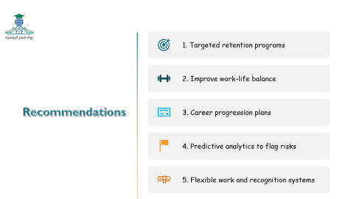
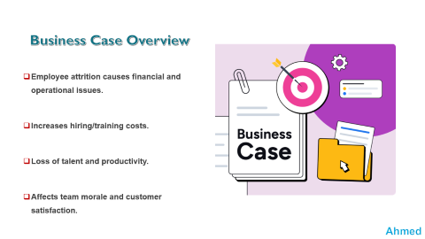
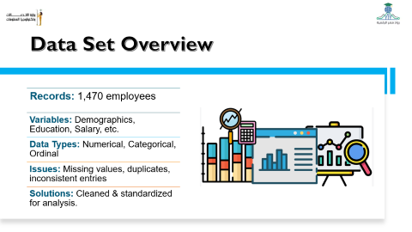
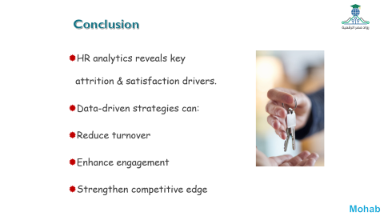
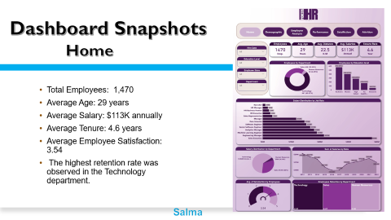
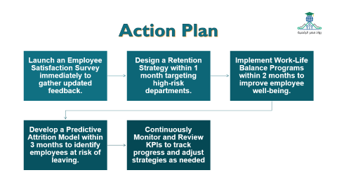

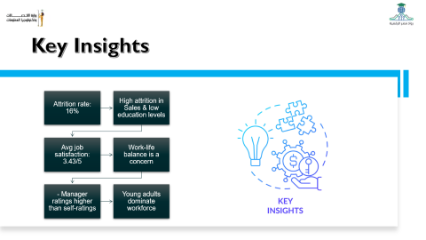
Objective
Key Insights
Action Plan
Business case overview
Dashboard Snapshots
Conclusion
Data set Overview
Recommendation

Slide 3


Objective
This HR analysis assesses employee satisfaction, retention, and performance to identify trends and inform strategies for improving engagement and workforce management.

Slide 4

Team Members
Ahmed Esmail
Adel Ragab
Sara Mohamed
Mohab Medany
Karim Shafie
Salma Saeed

Slide 5
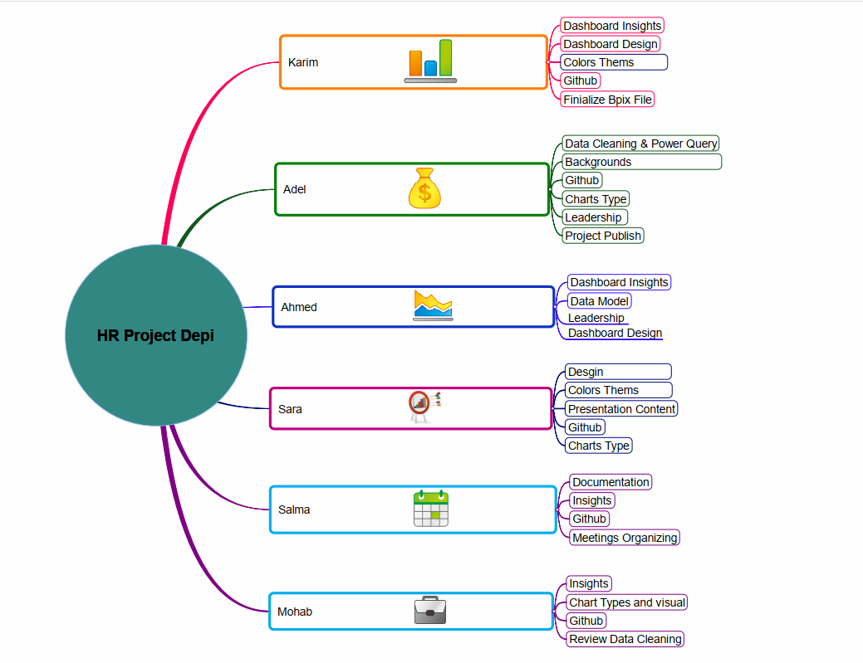
Team Members
Adel

Slide 6

Business Case Overview
Employee attrition causes financial and operational issues.
Increases hiring/training costs.
Loss of talent and productivity.
Affects team morale and customer satisfaction.
Ahmed

Slide 7

Data Set Overview
Records: 1,470 employees
Variables: Demographics, Education, Salary, etc.
Data Types: Numerical, Categorical, Ordinal
Issues: Missing values, duplicates, inconsistent entries
Solutions: Cleaned & standardized for analysis.
Karim

Slide 8

Key Insights
Attrition rate: 16%
High attrition in Sales & low education levels
Avg job satisfaction: 3.43/5
Work-life balance is a concern
- Manager ratings higher than self-ratings
Young adults dominate workforce
Karim

Slide 9
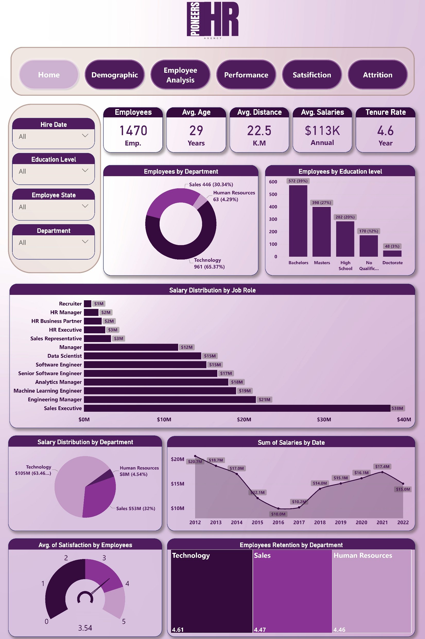
Dashboard Snapshots
Home
Total Employees: 1,470
Average Age: 29 years
Average Salary: $113K annually
Average Tenure: 4.6 years
Average Employee Satisfaction: 3.54
The highest retention rate was observed in the Technology department.
Salma

Slide 10
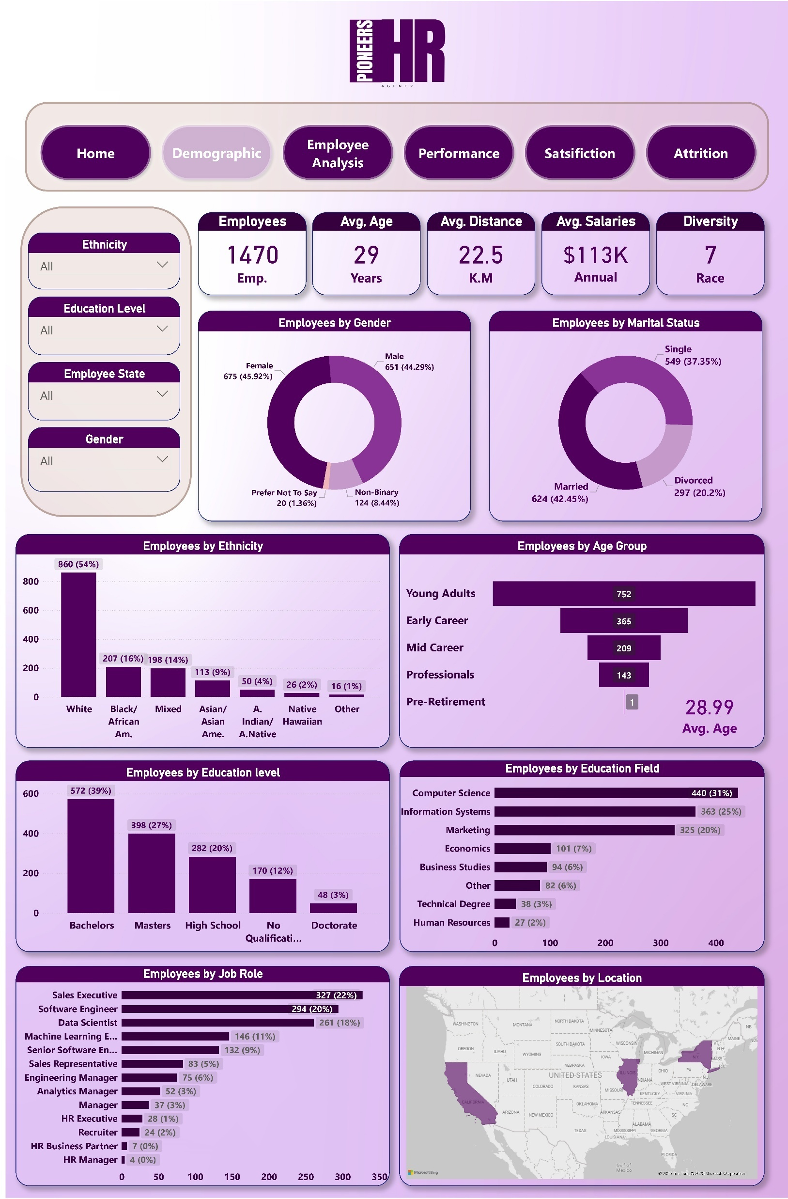
Demographic
Gender Distribution: Nearly equal (675 Female, 651 Male)
The majority of employees are Young Adults and Early Career professionals.
Most common education levels: Bachelor’s and Master’s degrees
Diverse workforce with the majority ethnicity being White, followed by Black/African American.
Top education fields: Computer Science, Information Systems, and Marketing.
Karim

Slide 11
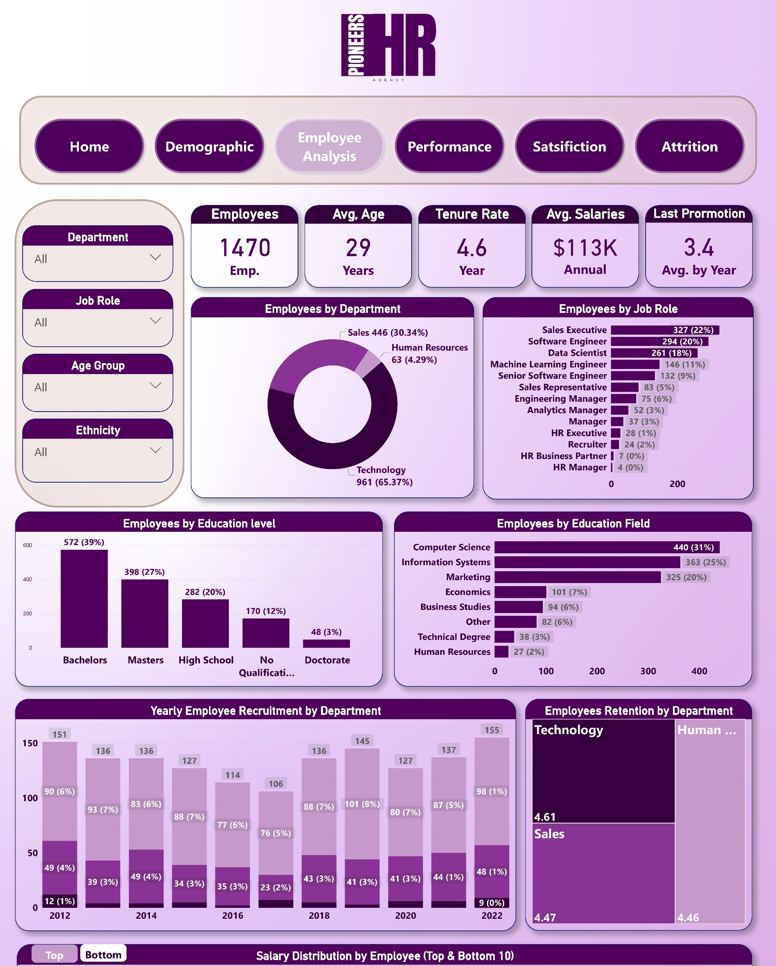
Employee analysis
Largest department: Technology (65%), followed by Sales (30%).
Most common job roles:
Sales Executive
Software Engineer
Data Scientist
Salary is heavily concentrated in technical and managerial positions.
Steady salary growth has been observed over the years.
Adel

Slide 12
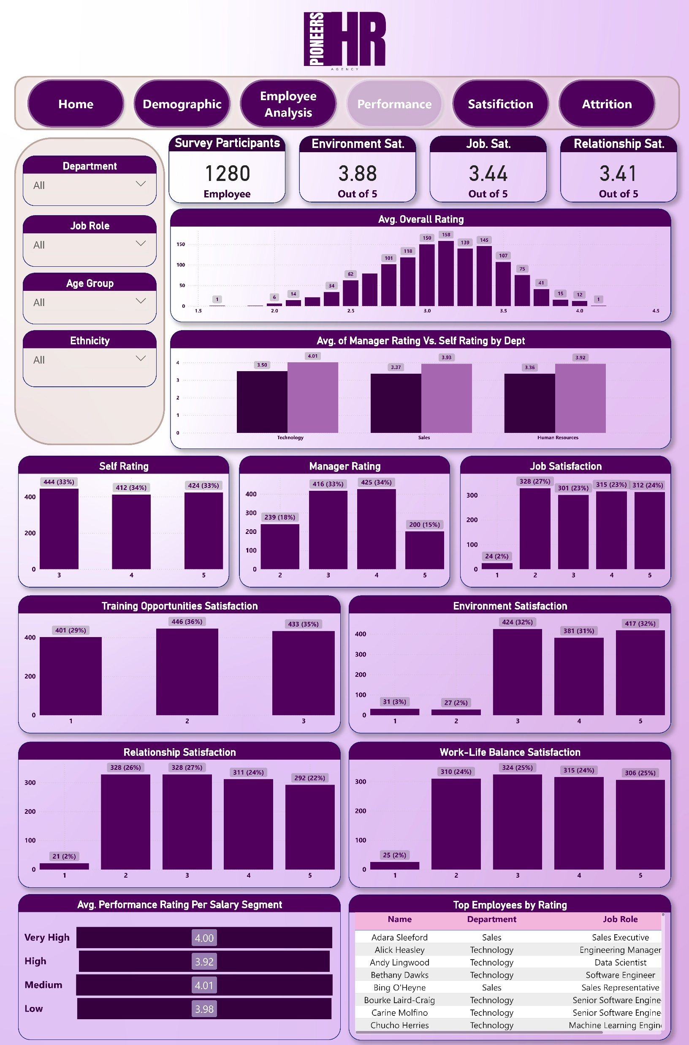
Performance
Manager ratings are generally higher than self-ratings across departments.
Top performers mainly belong to the Technology and Sales departments
.Average performance rating remains consistent across different salary segments
Environment satisfaction is relatively high (3.87 / 5).
Mohab

Slide 13
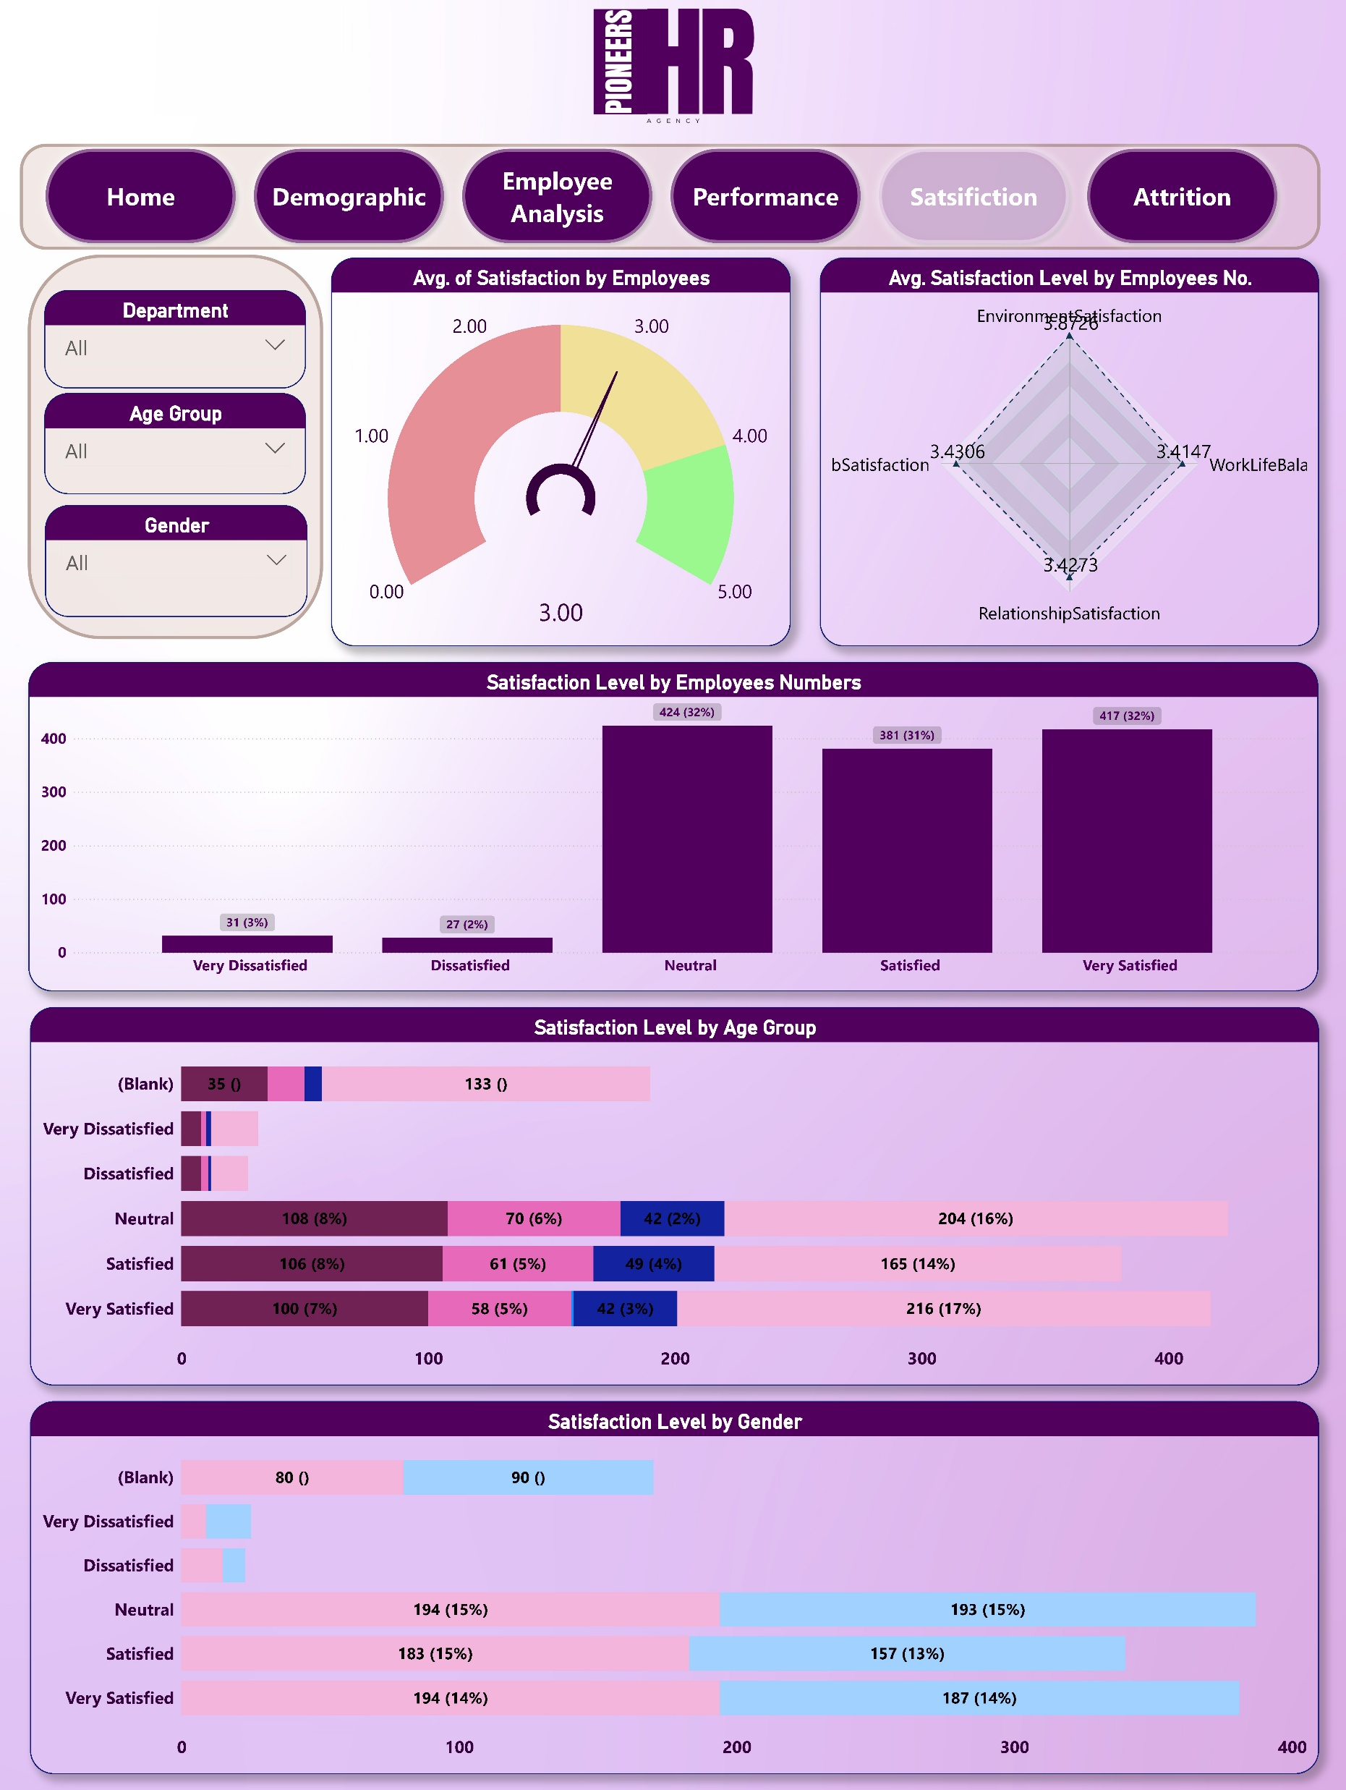
Satisfaction
The majority of employees report being Neutral to Satisfied.
Key satisfaction areas
(average scores out of 5):
Job Satisfaction: 3.43
Relationship Satisfaction: 3.43
Work-Life Balance: 3.41
Slightly higher satisfaction levels among females compared to males
Older age groups tend to report better satisfaction levels.
Ahmed

Slide 14
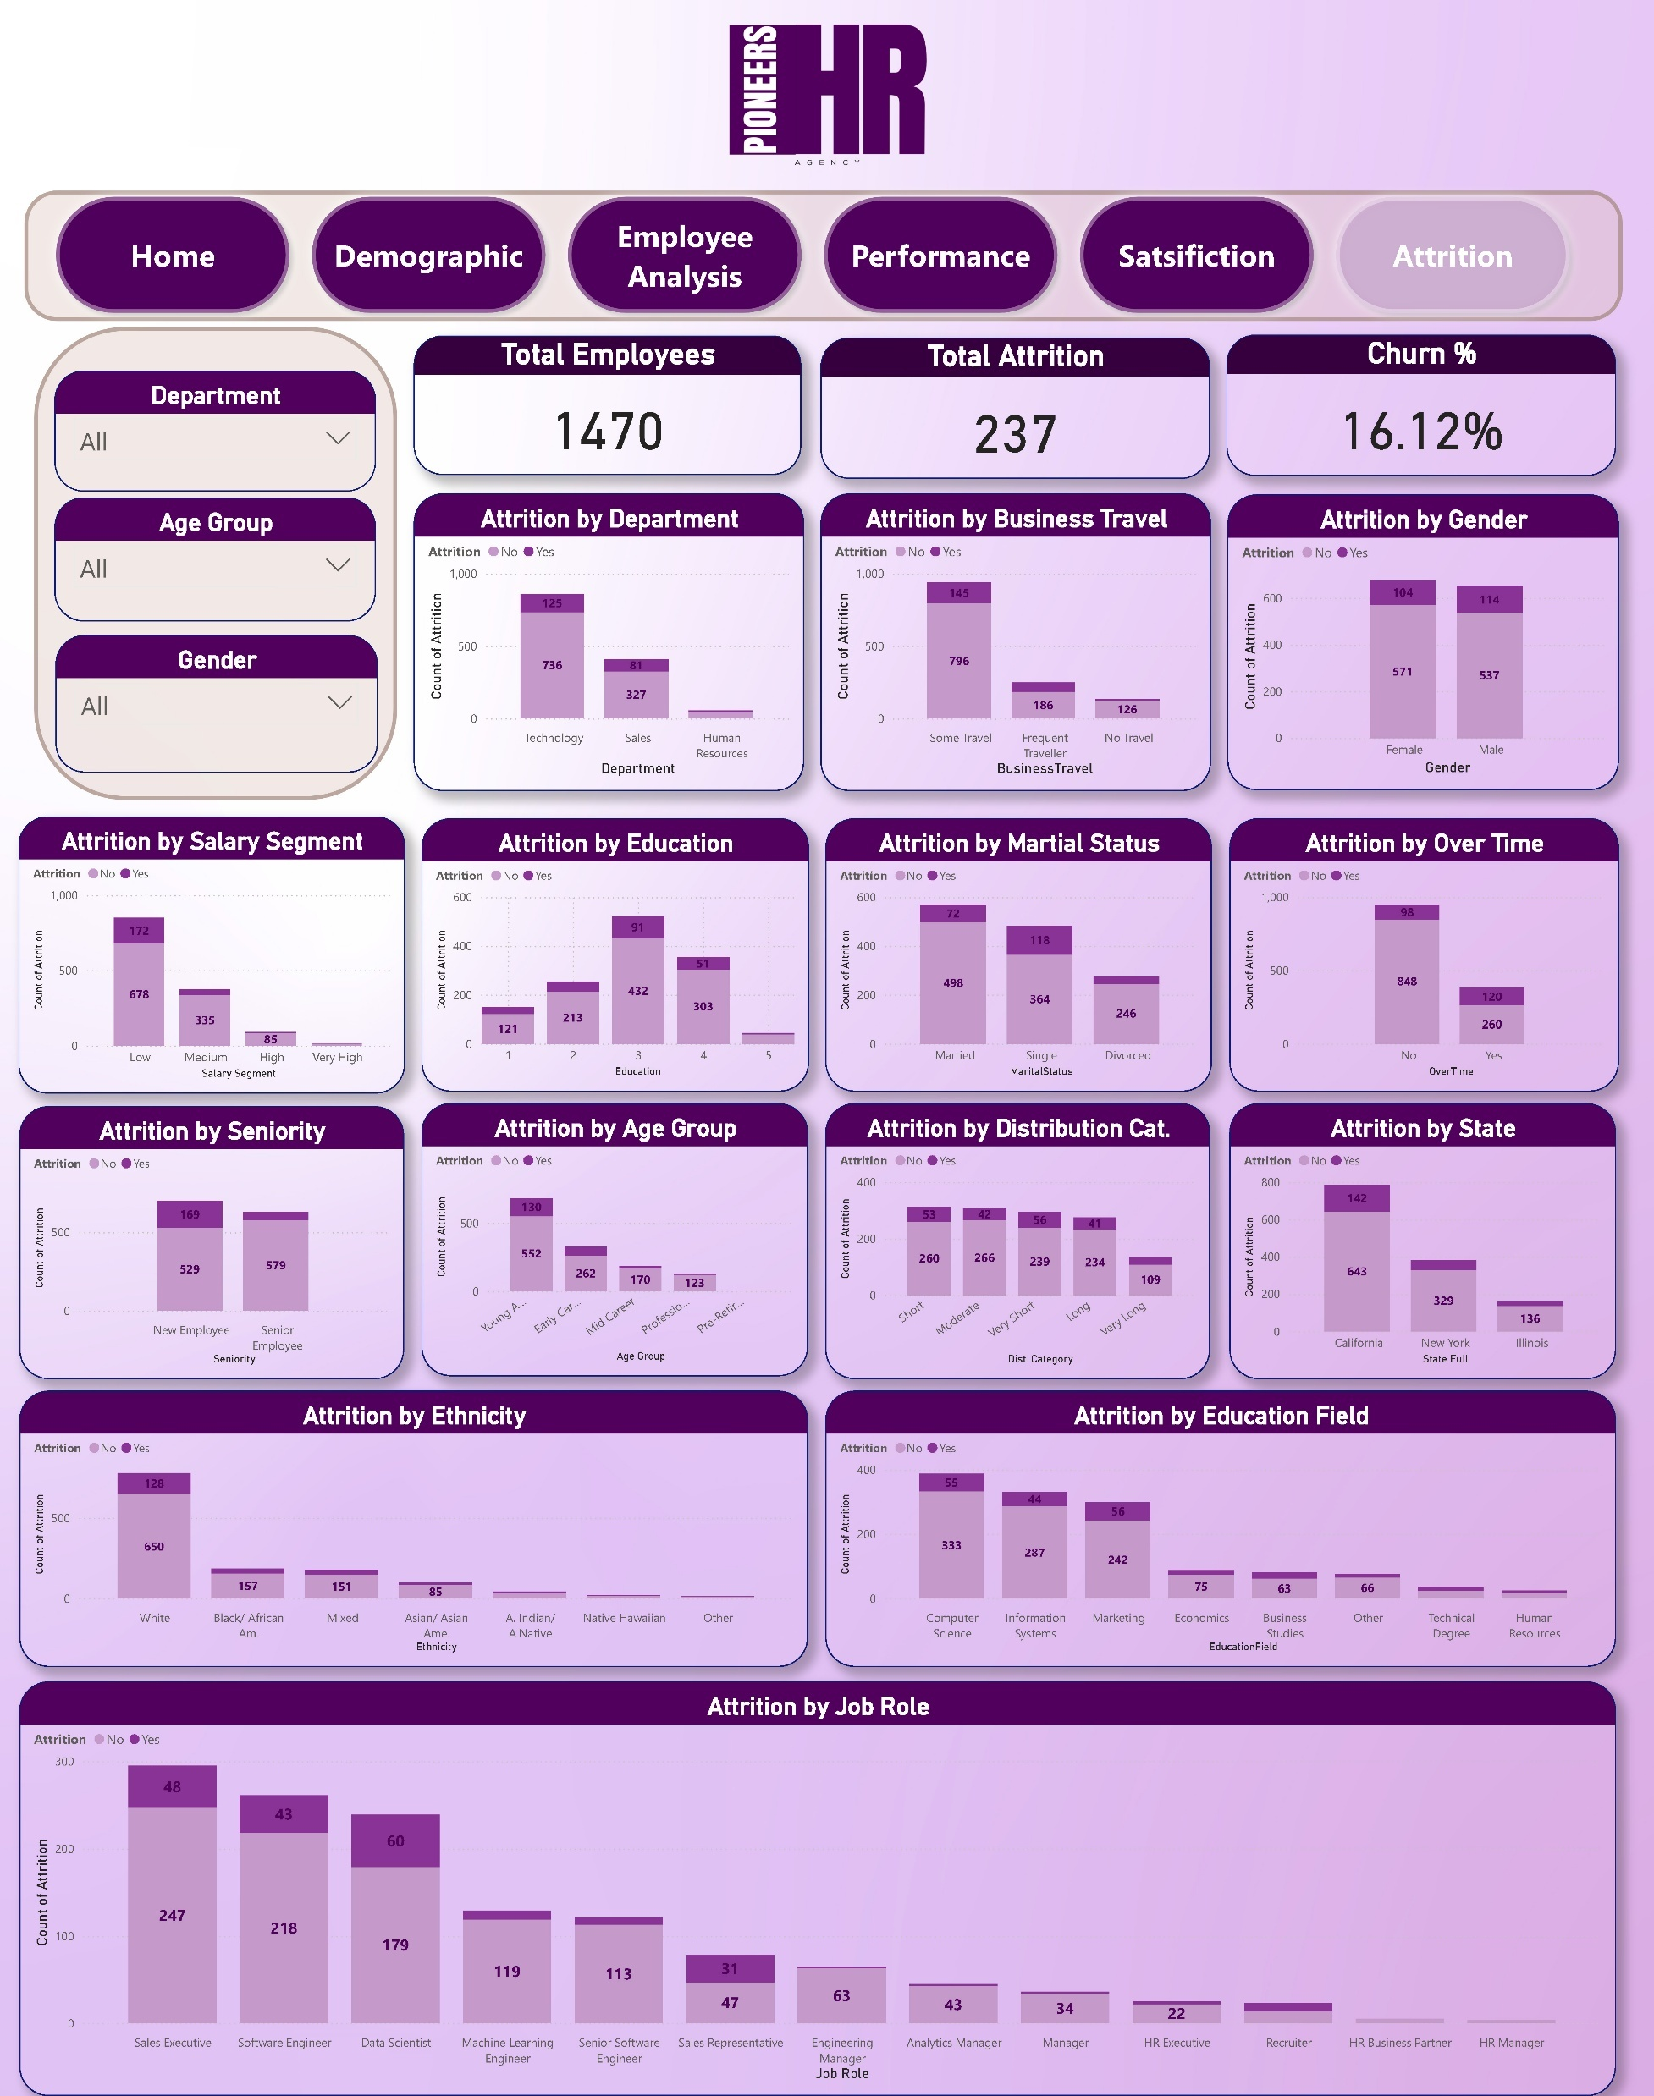
Attrition
Overall Attrition Rate: 16% (237 employees)
Highest attrition observed in: Sales Department
Employees with low salary segments
Those working frequently overtime
Single and divorced employees
Attrition is more common among early-career and young adult employees
States with the highest attrition: California and New York.
Employees with lower education levels and technical degrees show a higher churn rate
Ahmed

Slide 15

Recommendations
1. Targeted retention programs
2. Improve work-life balance
3. Career progression plans
4. Predictive analytics to flag risks
5. Flexible work and recognition systems
Sara

Slide 16
Action Plan
Launch an Employee Satisfaction Survey immediately to gather updated feedback.
Design a Retention Strategy within 1 month targeting high-risk departments.
Implement Work-Life Balance Programs within 2 months to improve employee well-being.
Develop a Predictive Attrition Model within 3 months to identify employees at risk of leaving.
Continuously Monitor and Review KPIs to track progress and adjust strategies as needed
Sara

Slide 17

Conclusion
HR analytics reveals key attrition & satisfaction drivers.
Data-driven strategies can:
Reduce turnover
Enhance engagement
Strengthen competitive edge
Mohab

Slide 18
Thank You!
Presented by: Digital Egypt Pioneers Team

